Slide 1



Semi-supervised Credit Card Fraud Detection via Attribute-driven Graph Representation
Sheng Xiang¹, Mingzhi Zhu², Dawei Cheng², Enxia Li¹, Ruihui Zhao³ , Yi Ouyang³, Ling Chen¹, Yefeng Zheng³
¹ The University of Technology Sydney, ² Tongji University,
³ Tencent Jarvis Lab
AAAI 2023
Notes:
Hello, everyone, I am Sheng Xiang from the University of Technology Sydney. Today I am very glad to introduce our work, Semi-supervised Credit Card Fraud Detection via Attribute-driven Graph Representation.

Slide 2
Content
Background.
Method.
Experiments.
Conclusion and Future Work
Notes:
Im going to introduce our work by four parts. Firstly, the background, then follows method and experiments. And finally, several conclusions.

Slide 3
Content
Background.
Method.
Experiments.
Conclusion and Future Work

Slide 4
Background
Credit Card Fraud
30 billion
US dollars in 2022
Notes:
Credit card fraud is an important issue and incurs a considerable cost for both cardholders and issuing institutions. Global card fraud losses amounted to over 30 billion US dollars in 2022 and is forecast to continue to increase. This huge amount of losses has increased the importance of fraud-fighting.

Slide 5
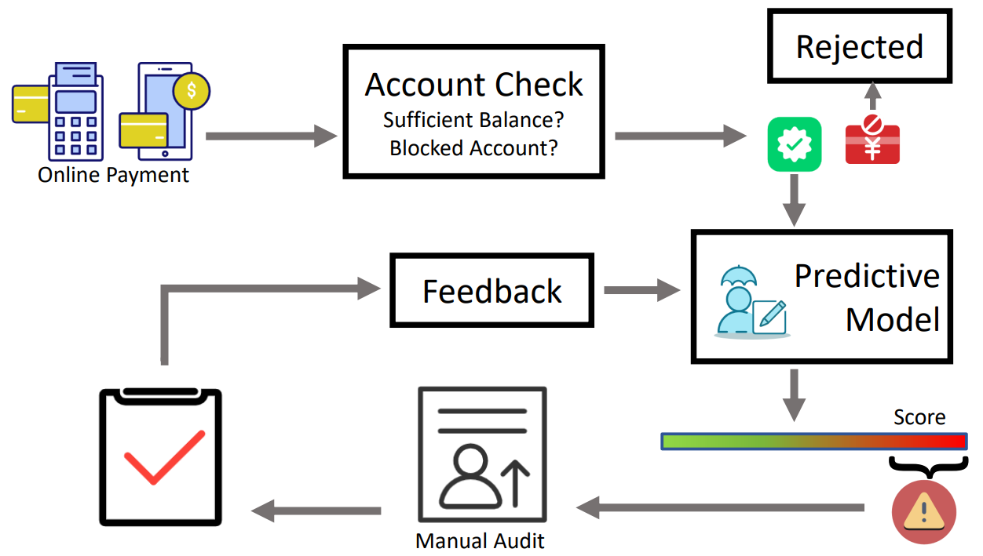
Background
Framework of Credit Card Fraud Detection
Notes:
This figure shows a typical fraud detection framework deployed in a commercial system. The card alliance or banks assess each transaction with an online predictive model once it has passed card checking. Unlike a simple card-checking system, which focuses on card blacklists and budget checking, the predictive model is designed to detect fraud patterns automatically and produces a fraud risk score. Investigators can thereby focus on high-risk transactions effectively.

Slide 6

Background
Observations from Real-world Fraud Transactions
Expensive Annotation Categorical Attributes
Attribute
Card Type
…
Attribute
Channel id
Currency id
…
Attribute
Mchnt Type
Term type
…
Notes:
We summarize the following two major observations from real-world fraud transactions:
First, the labeled data is expensive.
The number of fraudulent transactions is much less than legitimate ones. Therefore, it's difficult to achieve satisfactory performance through supervised methods.
Second, there are many categorical attributes for each transaction, such as card type, card issuer, merchant type, and terminal type.
Although these attributes are heterogeneous and noisy in the real world, they also can help us find more fraud patterns.

Slide 7
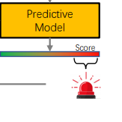
Background
Framework of Credit Card Fraud Detection
Previous
Rule-based methods
Machine learning-based methods
require manually construct features
Our Proposed model
Automatically unify heterogeneous categorical attributes through feature learning
Use the features and labels to detect fraud transactions without label leakage
Temporal aggregation using temporal graph attention layer
Notes:
Currently, many existing models are proposed for fraud detection. However, many of these methods require manually constructing features before feeding into a classification model, which fails to automatically learn the joint impact on temporal patterns and risk propagation.
Our model can automatically value the transaction importance through the feature learning layer and attention mechanism. Moreover, to uncover the hidden fraud patterns, we introduce a risk propagation and temporal attention mechanism to capture intrinsic relationships among transactions.

Slide 8
Content
Background.
Method.
Experiments.
Conclusion and Future Work
Notes:
Next is our proposed method.

Slide 9
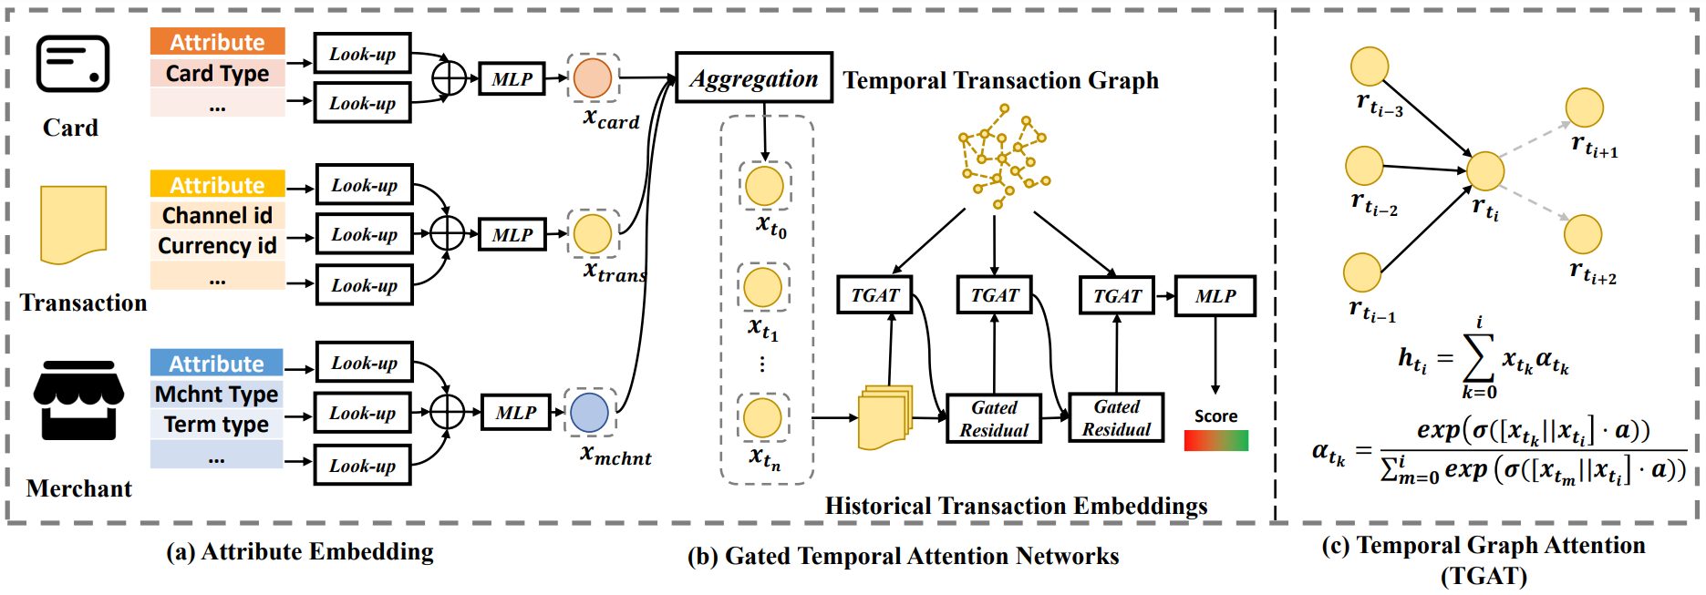
Method
Main architecture of GTAN
Notes:
We first have a look of the main framework of our proposed GTAN, then we will introduce each component.

Slide 10
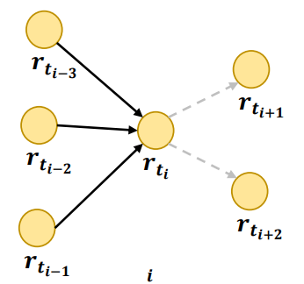
Method
Temporal transaction graph generation
Step 1: obtaining the time stamp of each transaction preprocessing the time attributes.
Step 2: the chronological order of transactions per user is determined according to time stamps.
Step 3: Connecting the edges whose target transaction time stamp is greater than the source transaction’s, and repeat step 3 for each user.
Notes:
The first part is the generation of a temporal transaction graph, which builds dynamic relations for transactions. Specifically, we have three steps to directly model the relations of transactions based on historical data. And represent them in a temporal graph.

Slide 11
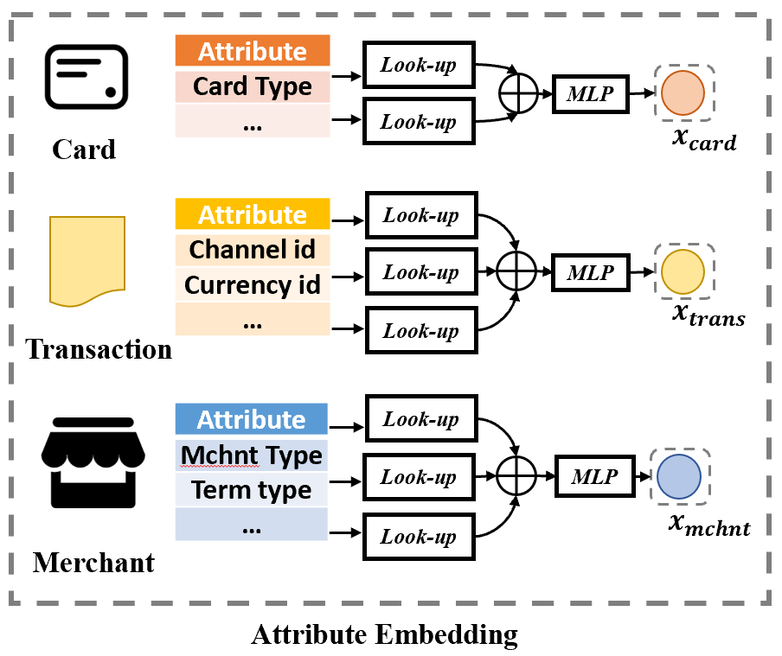
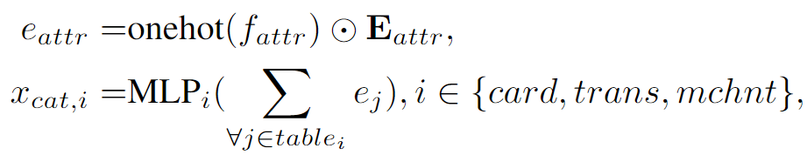
Method
Attribute Embedding
1)
2)
‘Attr’ is the attribute.
‘cat’ is the categorical attribute.
Notes:
After obtaining the transaction graph, we leverage attribute learning layer to encode the heterogeneous categorical attributes, which is illustrated in the right figure. In this part, we aggregate the representation of each attribute to encode the card, transaction, and merchant.

Slide 12
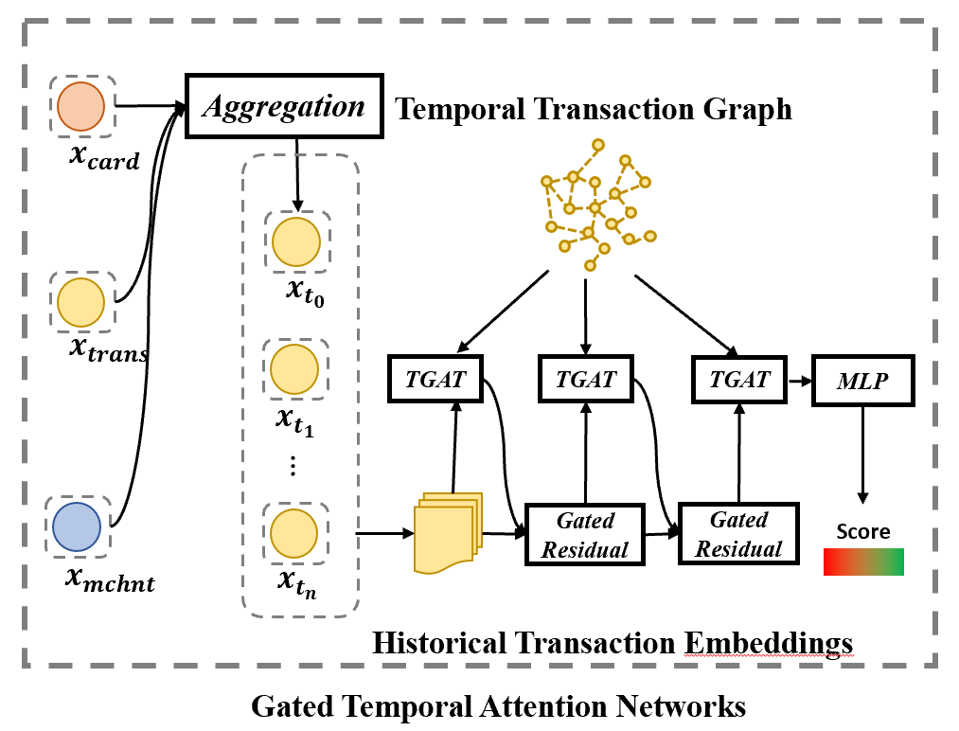

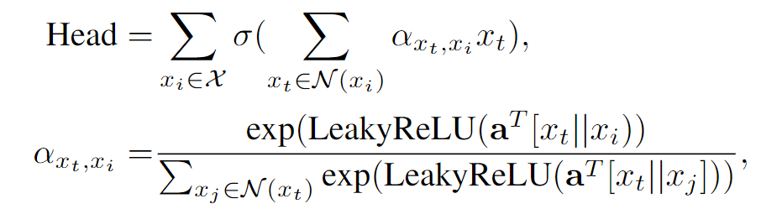
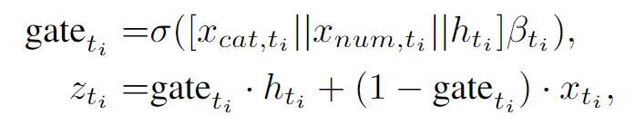
Method
Gated Temporal Attention Networks
3)
4)
5)
6)
7)
Temporal attention mechanism
Gated residual mechanism
Notes:
Then, we update each transaction’s representations by aggregating information from their neighbors in the temporal transaction graphs in two steps. The first step is a heterogeneous attribute aggregation. The second is a time-aware graph attention mechanism. The right figure shows the gated temporal attention networks, which adaptively calculates the importance of the neighbors and aggregates the information according to the neighbors’ importance.

Slide 13


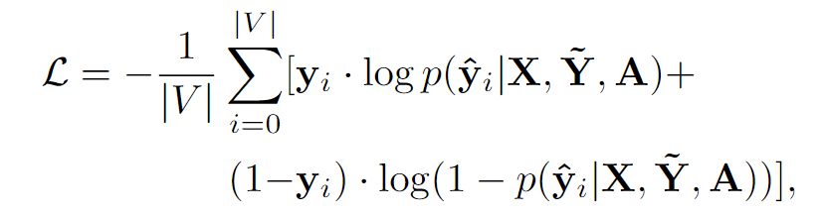
Method
Fraud Detection and Optimization
Risk propagation and fraud detection
Masking to avoid label leakage
Notes:
We also inject the label as one of the categorical attributes and give the mask to avoid label leakage.
After the graph neural network, we leverage a multi-layer perceptron to give the prediction of each stock’s future movement.

Slide 14
Content
Background.
Method.
Experiments.
Conclusion and Future Work
Notes:
Next is our experiments.

Slide 15
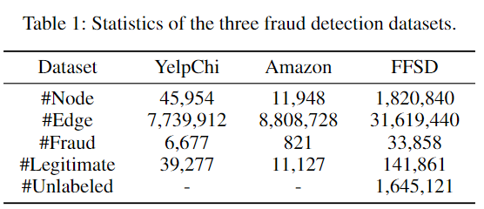
Experiments
Dataset Dataset statistics
We contribute a new large-scale partially labeled credit card fraud detection dataset to the research community, namely Finacial Fraud Semi-supervised Dataset (FFSD).
Besides, we also experimented on two public supervised fraud detection datasets. The YelpChi graph dataset and Amazon graph dataset.
Notes:
experiments are conducted in both the supervised fraud detection datasets and a semi-supervised dataset. The historical price data from 2016 to 2021 are chosen as our datasets. To the best of our knowledge, there is no public semi-supervised credit card fraud detection dataset. Therefore, we contribute a new large-scale partially labeled credit card fraud detection dataset to the research community, namely Finacial Fraud Semi-supervised Dataset (FFSD).

Slide 16
Experiments
Compared methods Evaluating metrics
Baseline Methods.
GEM.
FdGars.
Player2Vec.
GraphSAGE.
Semi-GNN
State-of-the-art methods:
GraphConsis
CARE-GNN
PC-GNN
Three popular metrics:
Averaged precision (AP)
Area under curve (AUC)
F-score
Notes:
We compared our proposed method with baseline methods and state-of-the-art methods.
Besides, we use three popular evaluating metrics to comprehensively evaluate the classification performance.

Slide 17
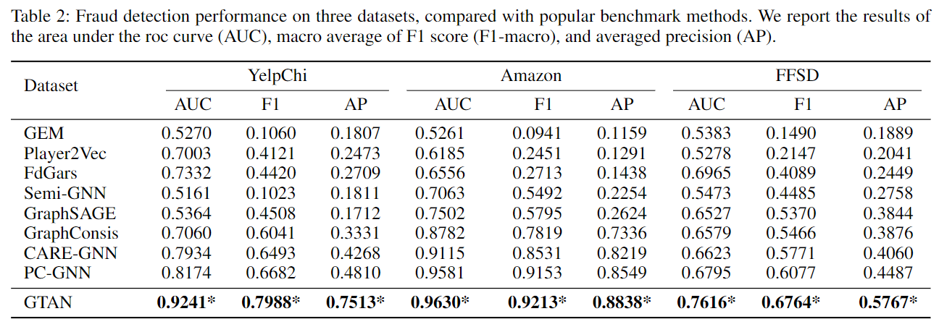
Experiments
Comprehensive Comparison
Notes:
we evaluate the overall performance of fraud detection, which is the main task of this paper. The first five rows of the Table show the performance of baseline models. It is clear that none of these five methods is satisfactory, and their performance is all lower than that of other baselines. Lines 6 to 9 of the Table show the performance of current state-of-the-art models. According to line 9, PC-GNN’s performance is competitive. This proves the effectiveness of addressing the problem of the small proportion of labels.
According to the last row of the Table, our GTAN outperforms all baselines and proves the superiority of our proposed graph neural network in fraud detection.

Slide 18
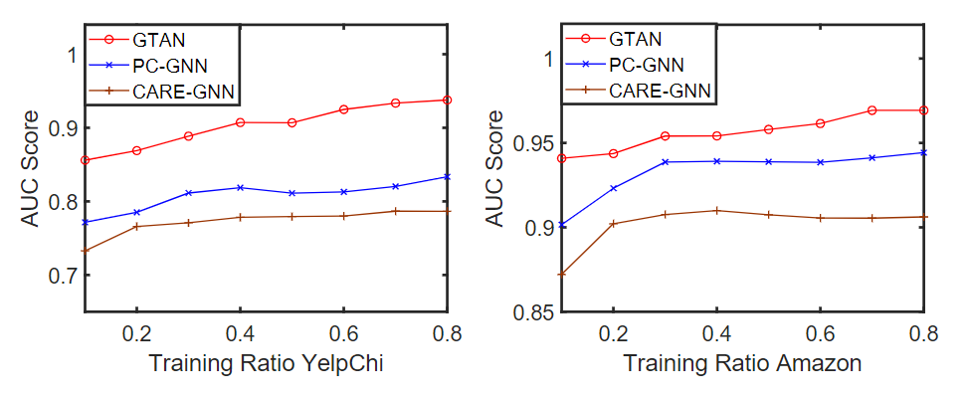
Experiments
The result of semi-supervised experiments with different ratios of labeled training data
Notes:
To further evaluate the performance of our model in semi-supervised experiment, we change the ratios of labeled data during the model training period. We report the AUC score of our model and other models in this Figure. Due to space constraints, we select some representative baselines to compare with our model. We can observe that our model stay ahead of other models no matter how many ratios of labels.

Slide 19
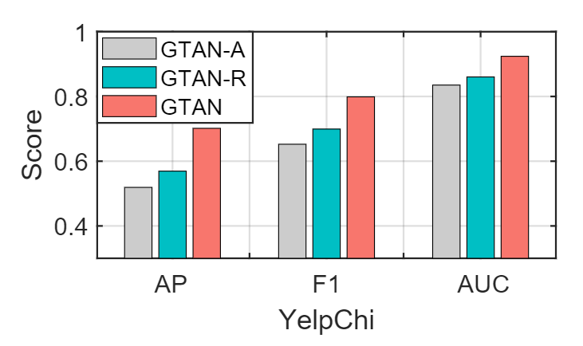
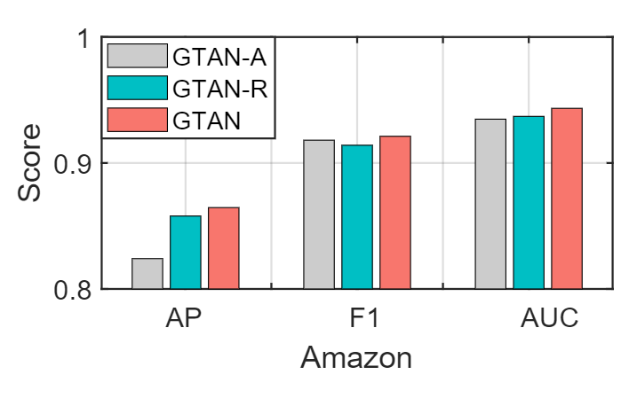
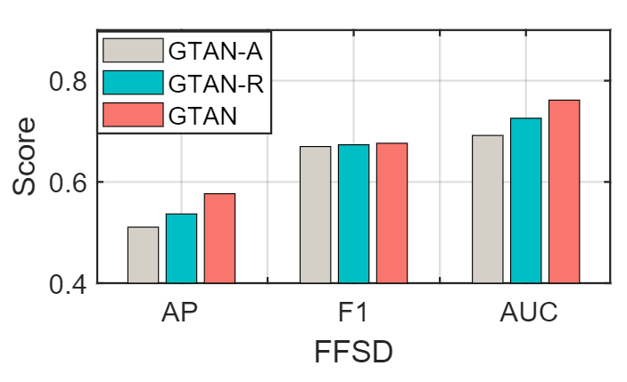
Experiments
Ablation Study
In the GTAN-A model, we remove the TGAT component, and the central node aggregates messages directly collected from neighboring nodes.
In the GTAN-R model, we remove the risk embedding component and only use the original node attributes.
Removing either component deteriorates the performance of GTAN, which proves that the temporal graph attention mechanism and risk embedding are both effective in graph-based fraud detection.
Notes:
The proposed model contains some key components, and we verify their effectiveness by ablating each component, respectively. Specifically, we evaluate two variants, namely GTAN-A and GTAN-R.
In the GTAN-A model, we remove the TGAT component, and the central node aggregates messages directly collected from neighboring nodes. In this case, we obtain the transaction embeddings from all the neighbor embeddings with the same weight instead of adaptively adjusting the weights of neighbor nodes. In the GTAN-R model, we remove the risk embedding component and only use the original node attributes.
The grey bars in the right Figure show the removal of the attention mechanism has the greatest impact on the accuracy metrics of the model. This proves that the reweighting of temporal transaction neighbors from the temporal graph attention mechanism is effective in our graph-based method. Besides, the green bars in the right Figure gets the second-highest scores compared with GTAN, which proves that the risk embedding is effective in modeling credit card fraud patterns from transaction risk propagation. In summary, removing either component deteriorates the performance of GTAN, which proves that the temporal graph attention mechanism and risk embedding are both effective in graph-based fraud detection.

Slide 20
Content
Background.
Method.
Experiments.
Conclusion and Future Work
Notes:
Next, we summarize our contributions.

Slide 21
Conclusion
We propose a semi-supervised graph learning framework to effectively model the risk propagation among transactions for fraud detection.
We design a temporal graph neural network model to learn the transaction representations by attention mechanism and gated residual mechanism.
Our proposed GTAN is interpretable and can be easily implemented in the industry-level system. Extensive experiments on both the financial fraud detection dataset and public fraud detection datasets demonstrate the superior performance of our proposed methods.
Notes:
First, We propose a graph learning framework to effectively model the relationship among transactions for fraud detection, which fits the real-world fraud patterns.
Second, We design a temporal graph neural network model to learn the transaction representations by attention mechanism and gated residual mechanism. The proposed model is concise and effective in joint and automatically learning from features and labels.
Third, Our proposed GTAN is interpretable and can be easily implemented in the industry-level system. Extensive experiments on both the financial fraud detection dataset and public fraud detection datasets demonstrate the superior performance of our proposed methods.

Slide 22
Thank you!
Sheng Xiang, University of Technology Sydney.
Sheng.xiang@student.uts.edu.au
Notes:
That’s all my presentation. Thank you very much for your listening.

Slide 23
Semi-supervised Credit Card Fraud Detection via Attribute-driven Graph Representation
Sheng Xiang¹, Mingzhi Zhu², Dawei Cheng², Enxia Li¹, Ruihui Zhao³ , Yi Ouyang³, Ling Chen¹, Yefeng Zheng³
¹ The University of Technology Sydney, ² Tongji University,
³ Tencent Jarvis Lab
AAAI 2023

