Slide 1




Temporal and Heterogeneous Graph Neural Network for Financial Time Series Prediction
October 17-21, 2022
Atlanta, Georgia, USA
Sheng Xiang¹, Dawei Cheng², Chencheng Shang³ , Ying Zhang¹, Yuqi Liang⁴
¹ The University of Technology Sydney, ² Tongji University,
³ Peking University, ⁴ Seek-data Group
CIKM 2022
Notes:
Hello, everyone, I am Sheng Xiang from the University of Technology Sydney. Today I am very glad to introduce our work, temporal and heterogeneous graph neural network for financial time series prediction.

Slide 2
Content
Background.
Method.
Experiments.
Conclusion
Notes:
Im going to introduce our work by four parts. Firstly, the background, then follows method and experiments. And finally, several conclusions.

Slide 3
Content
Background.
Method.
Experiments.
Conclusion

Slide 4
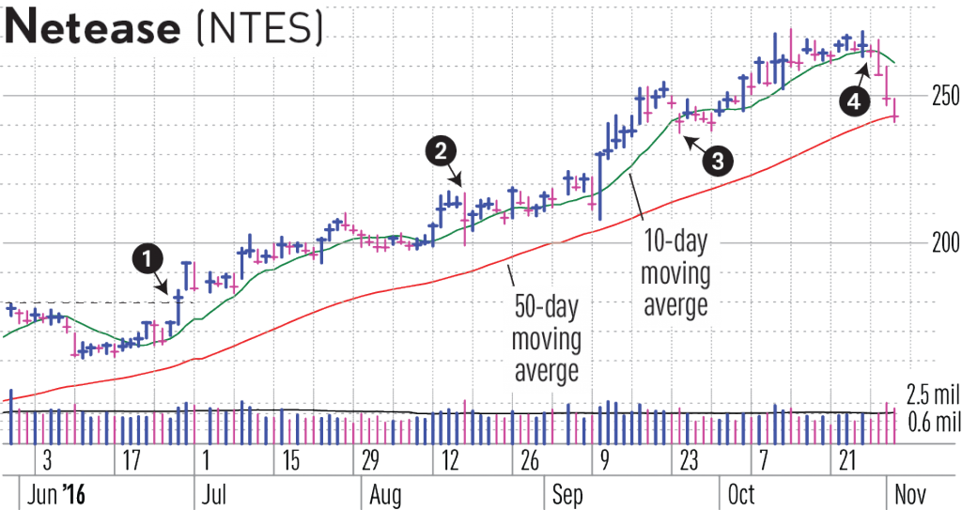
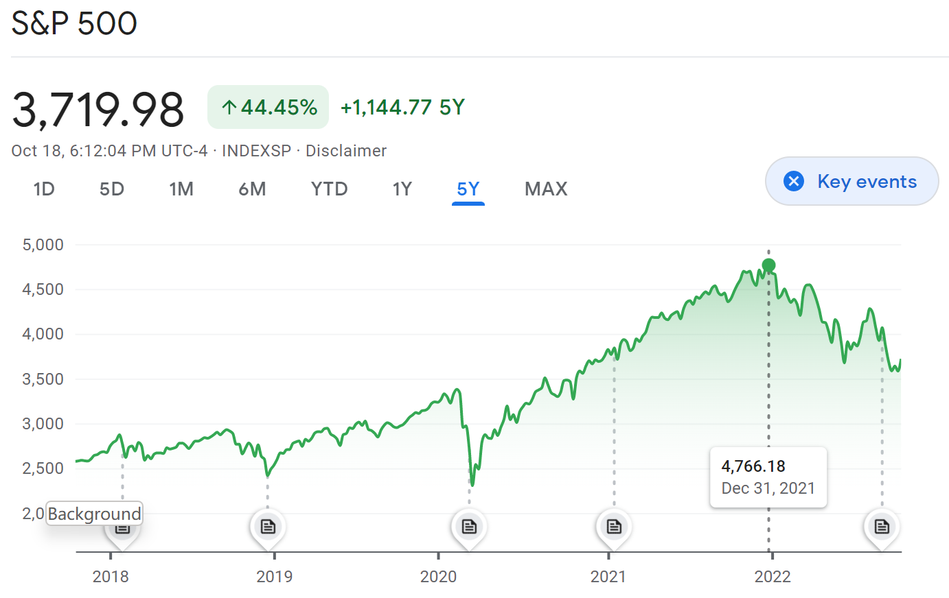
Background
Financial Time Series Prediction Task
Financial Time Series Prediction:
Time series prediction: extracting relevant features and predicting their future changes.
Financial time series prediction:
Future stock price prediction
Make investment decisions
Notes:
Time series prediction refers to extracting relevant features and predicting future changes through continuous observation and calculation of an entity within a certain period of time.
Financial time series prediction refers to extracting previous entity price movements and predicting future price changes to help make investment decisions.
In our paper, we focus on the prediction of stock price movements.

Slide 5

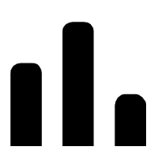

Background
Financial Time Series Prediction
Stock market has a global market capitalization of more than $80 trillion as of 2020.
However, stock price movement contains too much noise.
Future stock price prediction
All the available information
Investment decisions
Notes:
Stock market is a financial ecosystem that involves transactions between companies and investors, with a global market capitalization of more than $80 trillion as of 2020 [33]. The Efficient Market Hypothesis [31] points out that the stock price represents all the available information, but the stock price is always volatile, resulting in difficulty on predicting its movement [1].

Slide 6
Background
Financial Time Series Prediction
Financial status
Technical indicators
Machine Learning models
Online news
Social media posts
Future stock price prediction
All the available information
Investment decisions
Notes:
In recent years, machine learning has been widely used in predicting the price movement of stocks [24]. Researchers also explore to improve the prediction performance by incorporating more sources as model inputs, including more technical indicators [31], factors [14], financial status [2], online news [27], social media posts [40].

Slide 7
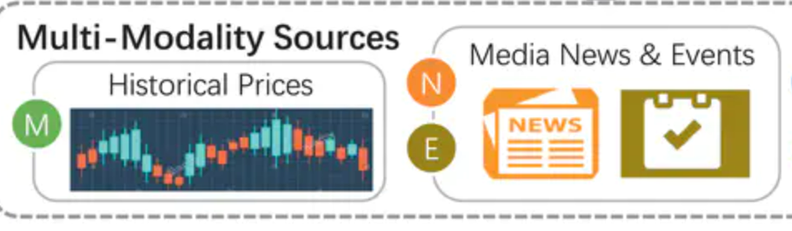
Background
Financial Time Series Prediction
Financial status
Technical indicators
Machine Learning models
Online news
Social media posts
Future stock price prediction
All the available information
Investment decisions
Notes:
It is widely known that price movements of stocks are affected by various aspects in financial market [14]. In previous studies, a common strategy is to manually construct various factors as feature inputs. For example, Integrating market signals with stock fundamental and technical indicators can help make investment decisions. Some researchers establish a link between news articles and the related entities for stock price movement forecasting. A large number of existing methods employ recurrent neural network and its variants, such as LSTM and GRU, to learn the sequential latent features of historical information and employ them for downstream prediction task.

Slide 8
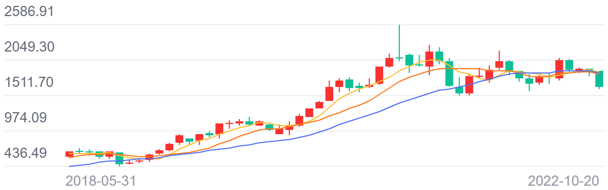
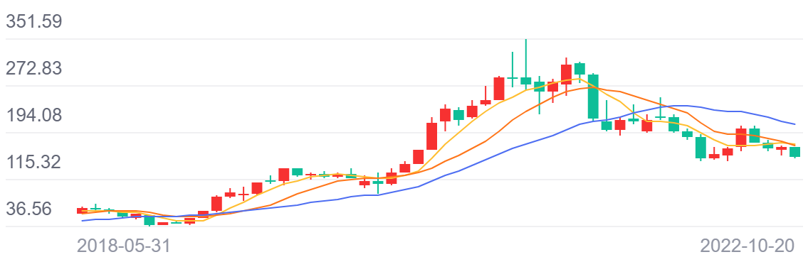
Background
Challenges
Observation: stocks may have similar price movement
For example, two listed companies in the same industry has similar price trend.
Limitation: previous work treats each stock independently
For example, long short-term memory (LSTM) is used to encode single stock.
(a) MOUTAI
(b) WULIANGYE
Notes:
Traditional learning methods treat the time series as independent and identically distributed to each other. But it is not coincident to the real situation in the financial market [26]. For example, two stocks in the same industry may have a higher correlation on price movement than those in different fields [4].

Slide 9
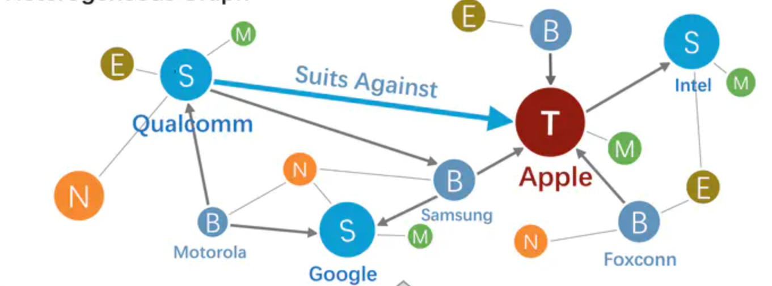
Background
Motivation: modeling company relations
Employ knowledge graphs.
Leverage graph learning for price movement prediction.
Notes:
Therefore, recent studies employ knowledge graphs to represent the internal relations among entities [7? ] and leverage graph learning for the price movement prediction [28]. Some works have shown the effectiveness by integrating stock’s relations in the prediction models [10]. Thus, graph-based methods may benefit from learning meaningful representations of inputs, resulting in better prediction accuracy [9, 35].

Slide 10
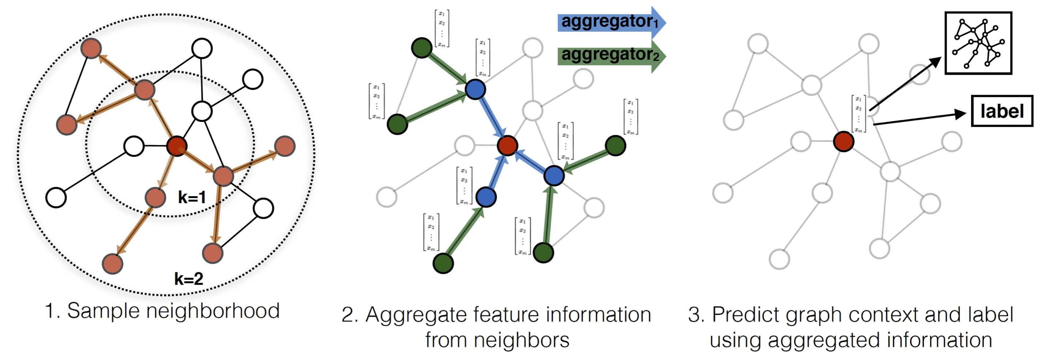
Background
Graph Neural Networks (GNNs)
Graph neural networks are leveraged in fraud detection, computer vision, and stock price prediction.
Notes:
Recently, graph neural networks are proposed to effectively learn on graph-structured data, which has shown its superior performance in various domains, including fraud detection, computer vision. Researchers also introduce the advanced Graph neural network-based approaches in the stock price prediction task.

Slide 11
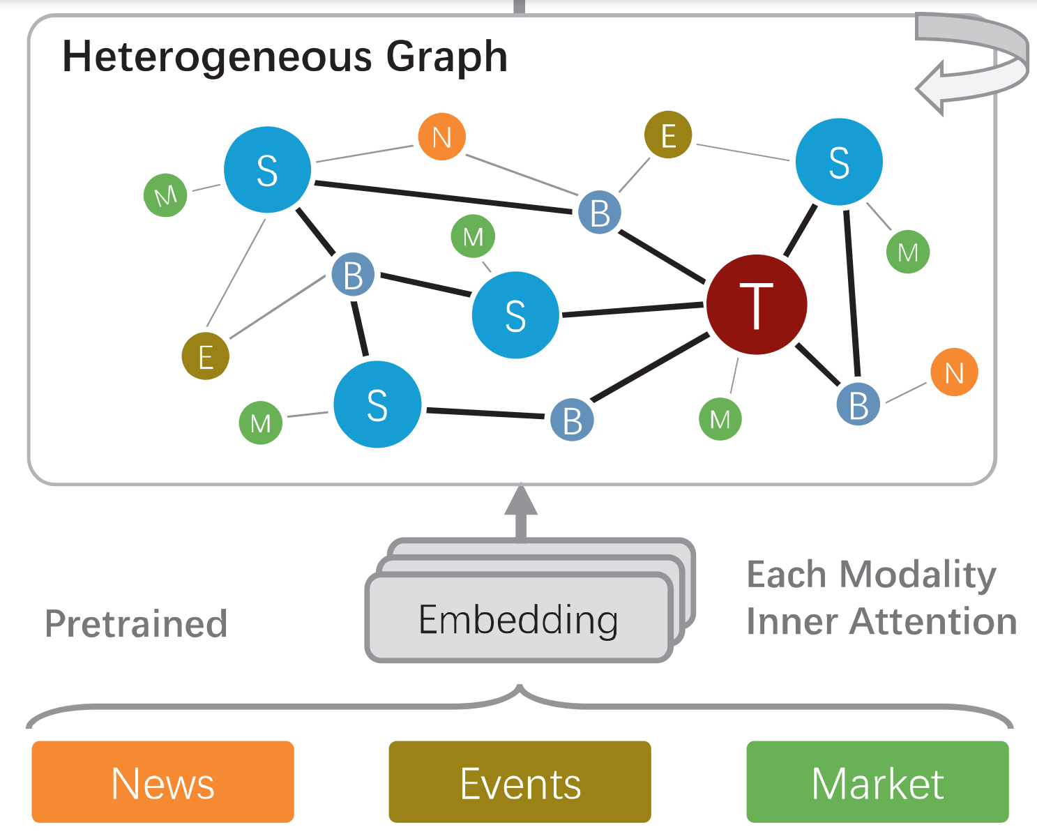
Background
GNN for Financial Time Series Prediction
Graph can be constructed by supply chain relationships, social media texts and company correlations.
Company Relation Graph can also be constructed by historical price series and associated events.
Notes:
For example, modeling the supply chain relationships of entities into knowledge graphs and using graph convolution networks can help predict stock movements. Leverage attentional graph neural network on the connections constructed by social media texts and company correlations. Some researchers leverage multi-modality graph neural network on the connections constructed by historical price series, media news, and associated events.

Slide 12
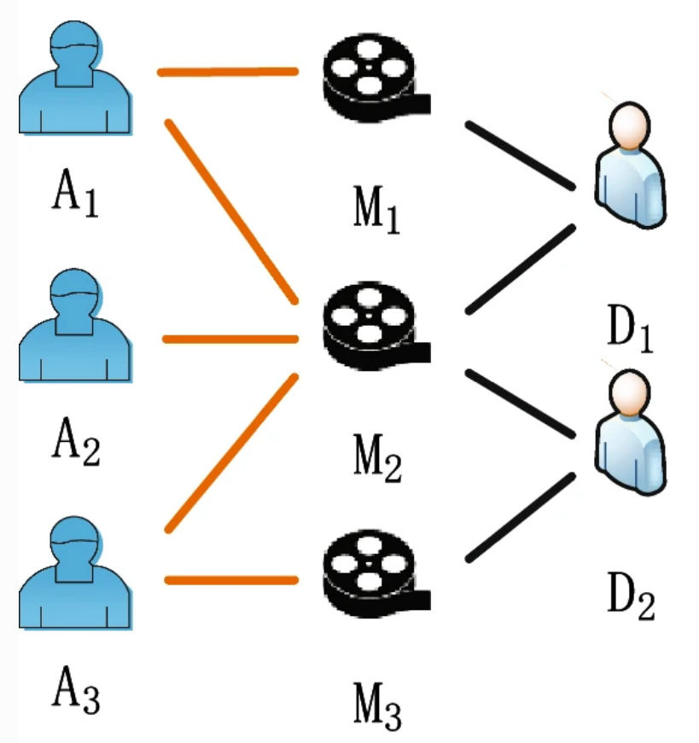
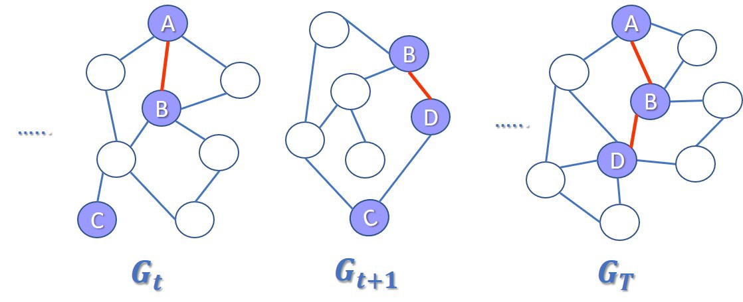
Background
Challenges: company relations are both dynamic and heterogeneous
Relations can be changed
Heterogeneous graph
Notes:
However, generating relation graphs of entities is very challenging because it is fluctuate, noisy, and dynamically changed. For example, financial knowledge graphs mainly include the supply chain, primary business and investment relations of entities, which is labeled by domain experts or extracted from unstructured texts. But different experts have different knowledge background which may lead to different relation graphs. Besides, the current nature language processing (NLP) techniques are still facing significant shortcomings in high accuracy relation extraction. In other words, the relations may be misled by either text news or inaccurate extracting models. In addition, these relations may dynamically change in time series. For example, the main business of a company would change according to the market demands. And the supply chain graph would be upgraded because of the technique evolution. Existing graph learning price prediction methods are inevitably suboptimal in learning these fluctuate and dynamical situations.

Slide 13
Background
Motivations: modeling dynamic and complex company relations
A novel approach using temporal and heterogeneous graph neural network.
1. Generating company relation graph day by day.
2. Adaptively aggregating messages from temporal neighbours.
3. Making investment decisions using the heterogeneous information from other companies.
Notes:
To address the above challenges, we propose a novel temporal and heterogeneous graph neural network-based method for financial time series prediction. This approach needs to aggregate messages from dynamic and heterogeneous neighbor nodes and make predictions for each listed company.

Slide 14
Content
Background.
Method.
Experiments.
Conclusion
Notes:
Next is our proposed method.

Slide 15
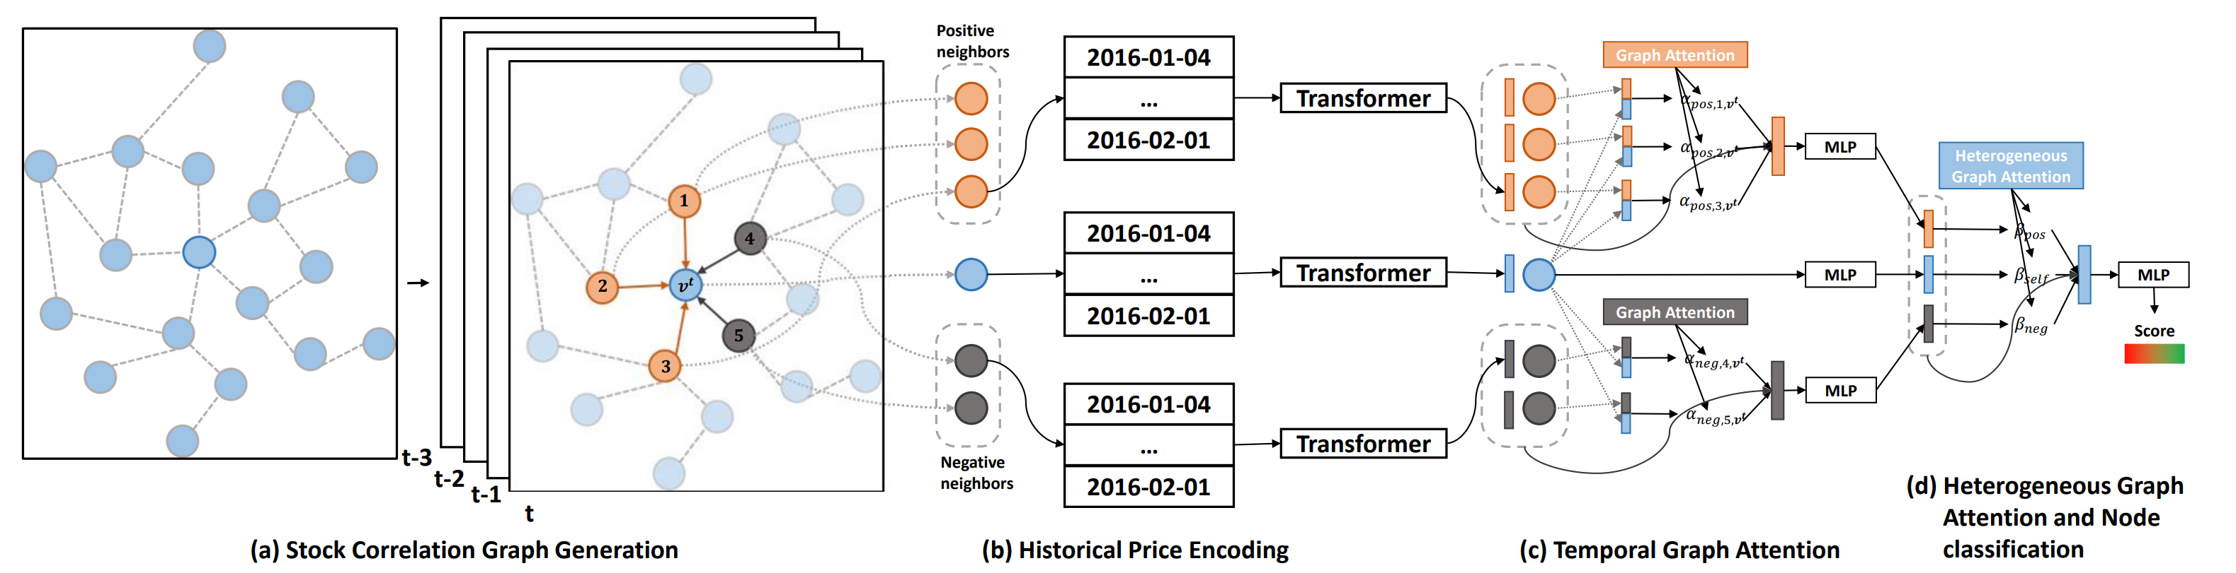
Method
Main architecture of THGNN
Notes:
We first introduce the main framework of our proposed THGNN, then we will introduce each component.

Slide 16
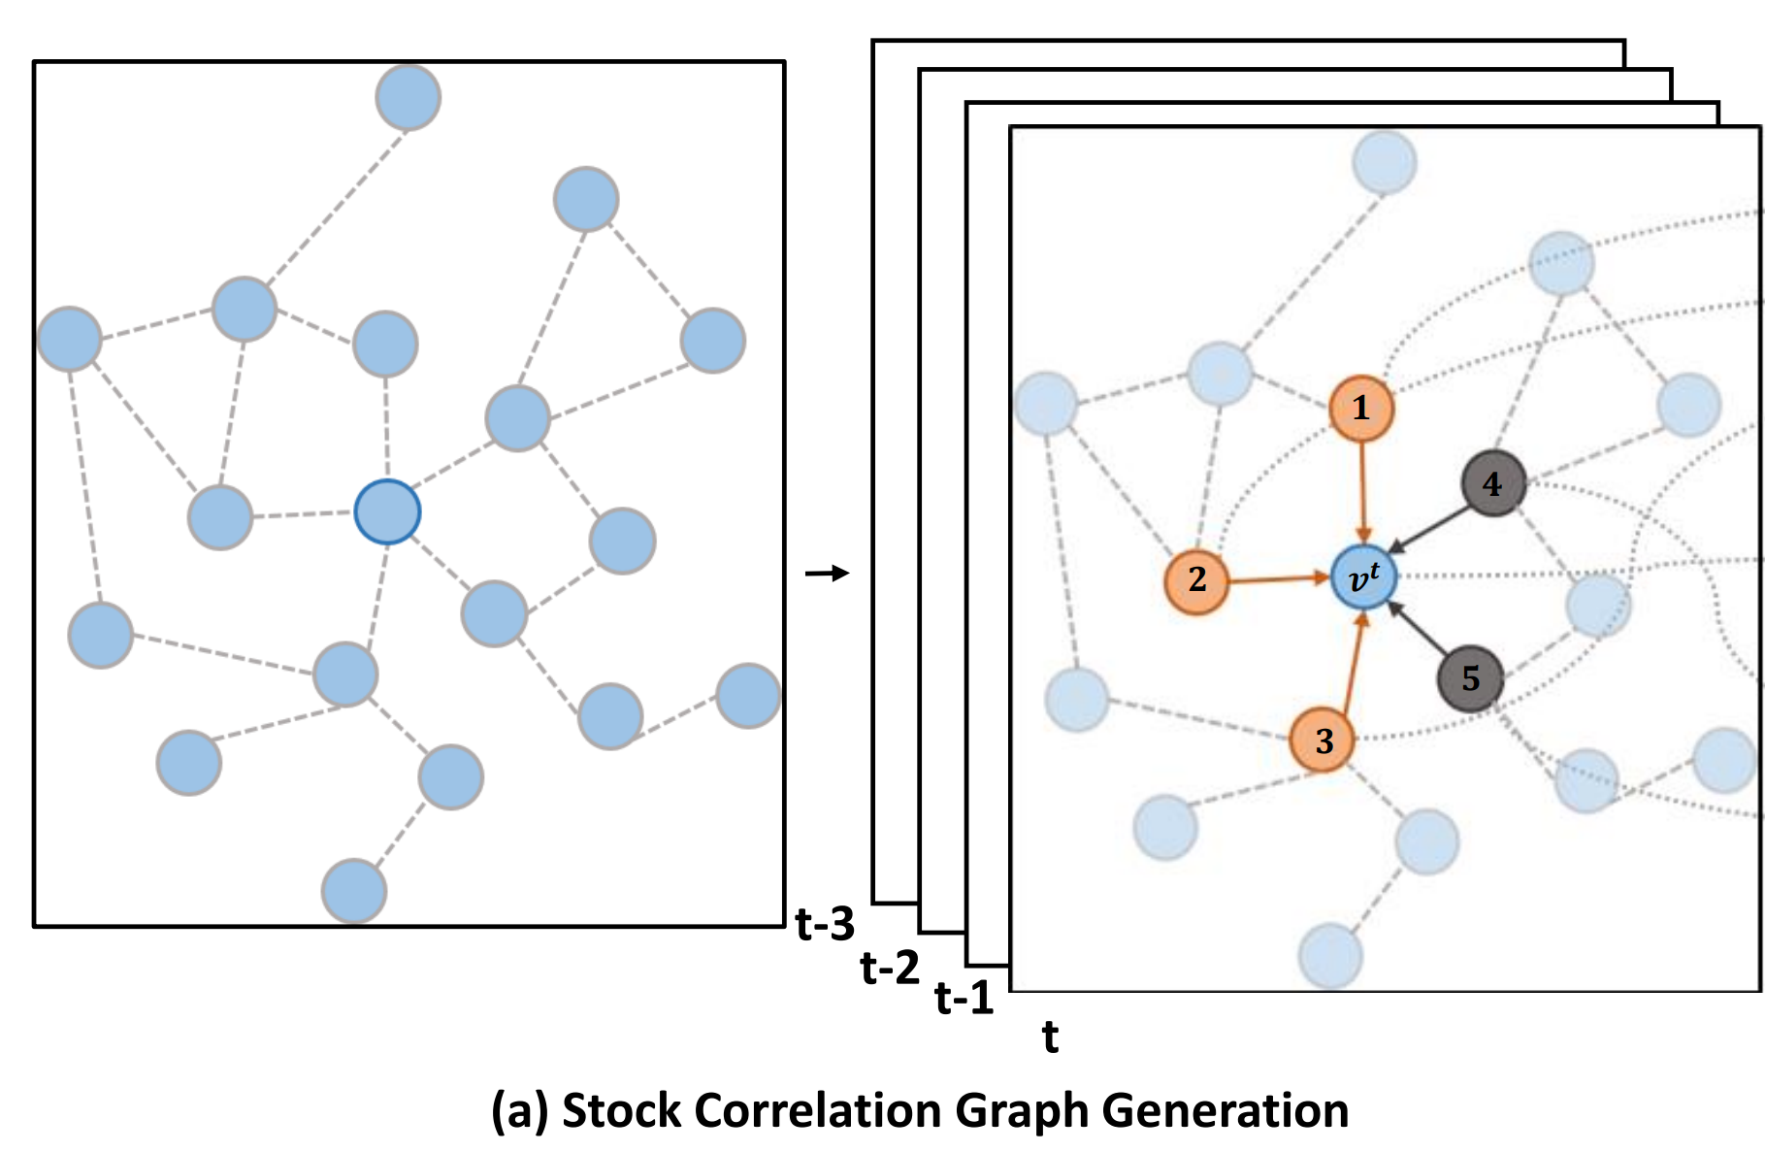
Method
Stock correlation graph generation
Step 1: obtaining the correlation matrix by calculating the correlation coefficients between ground-truth stock historical market signals directly.
Step 2: the relationship between companies is determined according to the value of each element of the correlation matrix.
Step 3: Connecting the edges whose absolute value is greater than the threshold, and the rest of the edges are not connected.
Notes:
The first part is the generation of a dynamic stock correlation graph, which builds dynamic relations for stocks in the market every trading day. Specifically, we have three steps to directly model the relations of price time series of entities based on historical data. And represent them in a temporal and heterogeneous company relational graph.

Slide 17
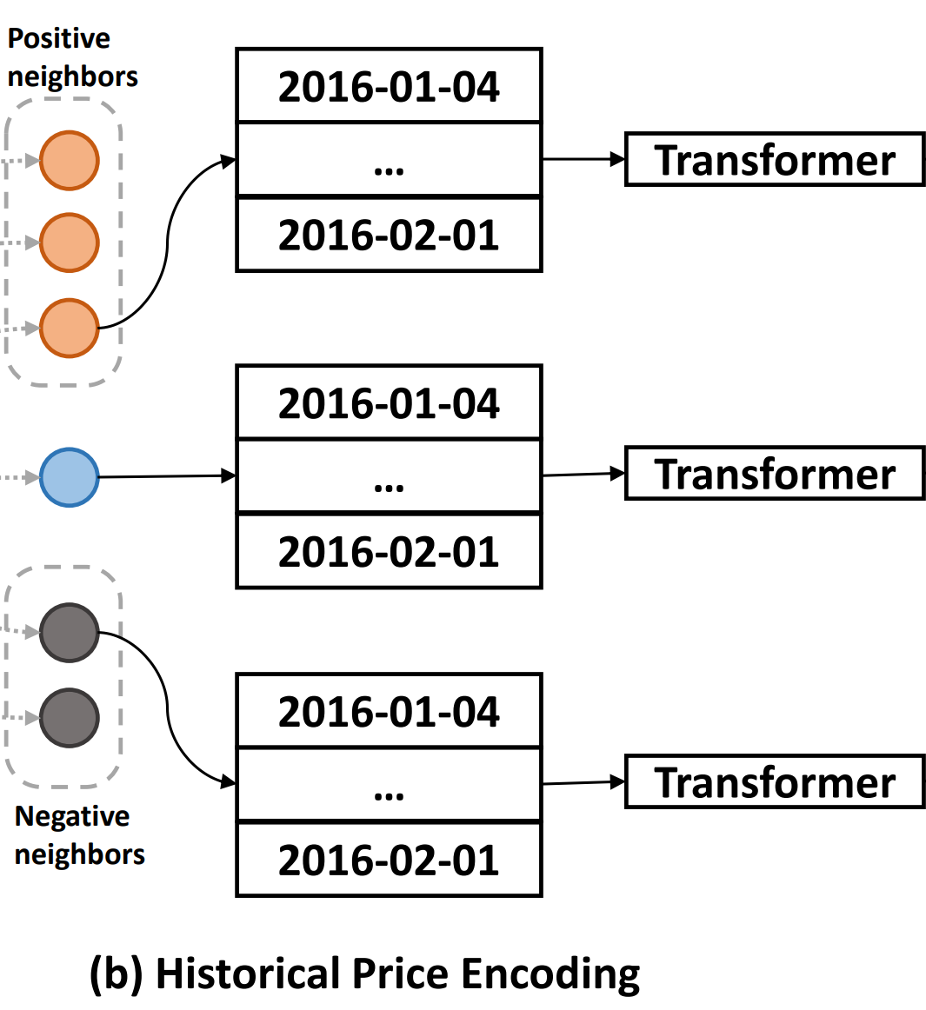
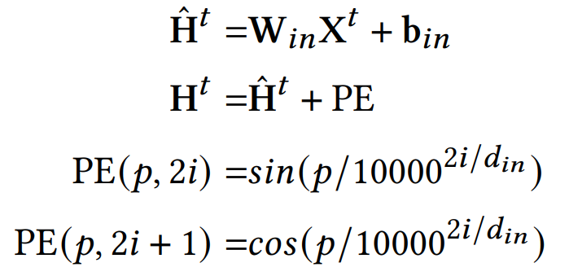
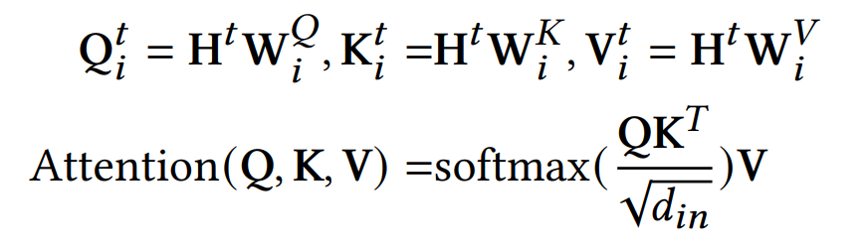
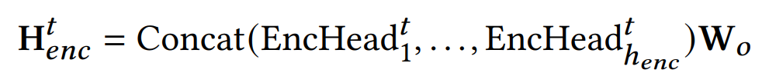
Method
Encoding stock historical movement
1)
2)
3)
Notes:
After obtaining the company relational graph, we leverage sequential transformers to encode the historical prices, which is illustrated in the right figure. In this part, we select a temporal node and its neighbor nodes to encode the historical price information. It should be noticed that all the encoders share their parameters.

Slide 18
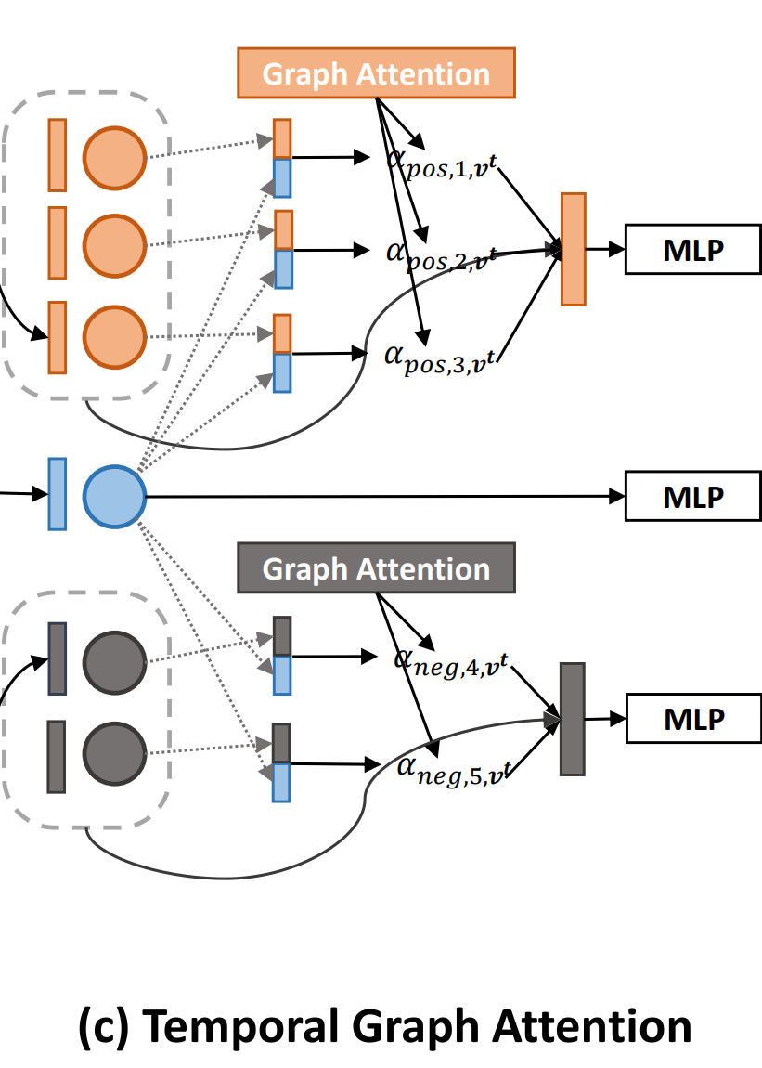
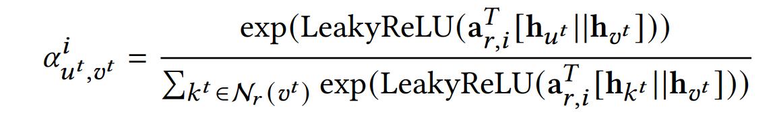
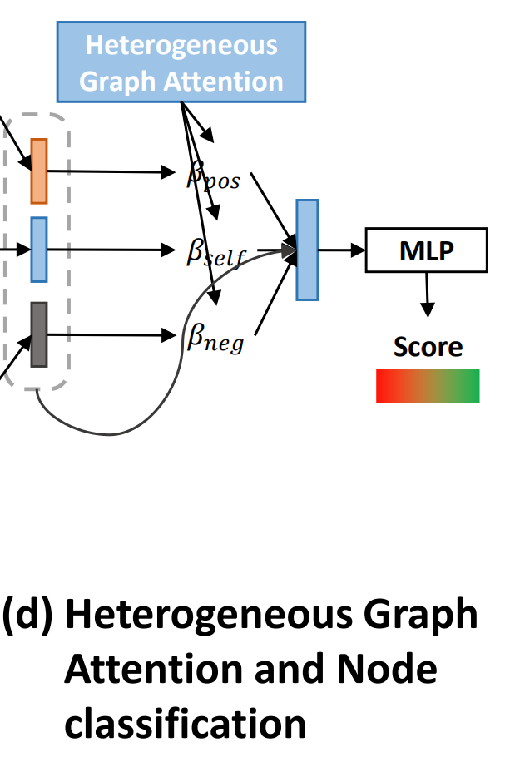
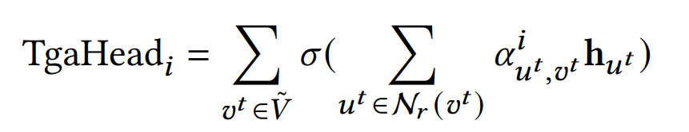
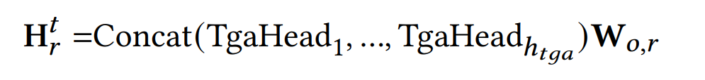
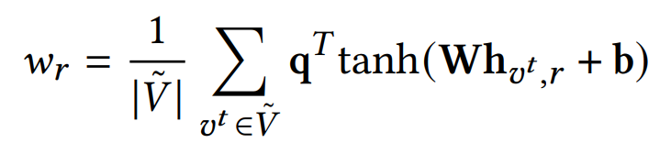
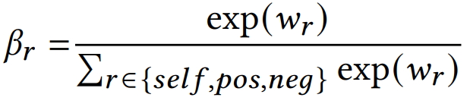
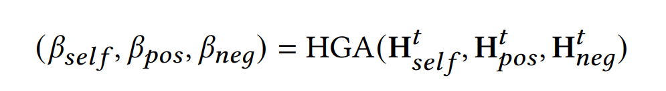
Method
Aggregating temporal and heterogeneous neighbors
Temporal attention mechanism
Heterogeneous attention mechanism
Notes:
Then, we update each company’s representations by aggregating information from their neighbors in company relational graphs in two steps. The first step is a time-aware graph attention mechanism. The second is a heterogeneous graph attention mechanism. The c figure shows the temporal graph attention layer, which adaptively calculates the importance of the neighbors and aggregates the information according to the neighbors’ importance. Then, the d figure shows the heterogeneous graph attention layer, which adaptively calculates the importance and aggregates information from different types of neighbors. Then, we leverage a multi-layer perceptron to give the prediction of each stock’s future movement.

Slide 19
Content
Background.
Method.
Experiments.
Conclusion
Notes:
Next is our experiments.

Slide 20
Experiments
Dataset Trading Protocol
Experiments are conducted in both the Unite States and China’s stock markets by choosing the constituted entities in S & P 500 and CSI 300 index.
The historical price data from 2016 to 2021 are chosen as our datasets.
The stock price correlation matrix of each trading day is determined by the historical price movement of past 20 trading days.
Each trading day during the test period (from January 1, 2020 to December 31, 2020), we use simulated stock traders to predict transactions:.
When the trading day 𝑡 closes, traders use this method to get the prediction score.
When the trading day 𝑡 + 1 opens: the trader sells the stock bought yesterday. Meanwhile, traders buy the stocks with top-𝑘 scores.
If a stock is continuously rated with the highest expected return, the trader holds the stock.
Notes:
experiments are conducted in both the Unite States and China’s stock markets by choosing the constituted entities in S & P 500 and CSI 300 index. The historical price data from 2016 to 2021 are chosen as our datasets. In addition to historical price data, our input data also includes company relation graphs, which are generated by the stock price correlation matrix.
As to Trading protocol, we use the daily buy-hold-sell trading strategy to evaluate the performance of stock movement prediction methods in terms of returns. During each trading day of the test period, we use simulated stock traders to predict transactions:

Slide 21
Experiments
Dataset Trading Protocol
Experiments are conducted in both the Unite States and China’s stock markets by choosing the constituted entities in S & P 500 and CSI 300 index.
The historical price data from 2016 to 2021 are chosen as our datasets.
The stock price correlation matrix of each trading day is determined by the historical price movement of past 20 trading days.
Each trading day during the test period (from January 1, 2020 to December 31, 2020), we use simulated stock traders to predict transactions:.
When the trading day 𝑡 closes, traders use this method to get the prediction score.
When the trading day 𝑡 + 1 opens: the trader sells the stock bought yesterday. Meanwhile, traders buy the stocks with top-𝑘 scores.
If a stock is continuously rated with the highest expected return, the trader holds the stock.
Notes:
When the trading day 𝑡 closes, traders use this method to get the prediction score, that is, the ranking of the predicted rate of return of each stock.
When the trading day 𝑡 + 1 opens: the trader sells the stock bought on the trading day 𝑡. Meanwhile, traders buy stocks with high expected returns, that is, the stocks with top-𝑘 scores.
Please note that if a stock is continuously rated with the highest expected return, the trader holds the stock.

Slide 22
Experiments
Compared methods Evaluating metrics
Sequential-based Methods.
LSTM.
GRU.
Transformer.
eLSTM.
Graph-based methods:
LSTM-GCN.
LSTM-RGCN.
TGC.
MAN-SF
HATS
REST
AD-GAT
Seven popular metrics:
prediction accuracy (ACC)
annual return rate (ARR)
annual volatility (AV)
maximum draw down (MDD)
annual sharpe ratio (ASR)
calmar ratio (CR)
information ratio (IR)
Notes:
We compared our proposed method with state-of-the-art sequential-based models as well as the graph-based approaches. They are 1) Non-graph-based Methods, includes LSTM [17], GRU [11], Transformer [39], eLSTM [24]. 2) Graph-based Methods.
Besides, we use seven popular evaluating metrics to comprehensively evaluate the performance.

Slide 23
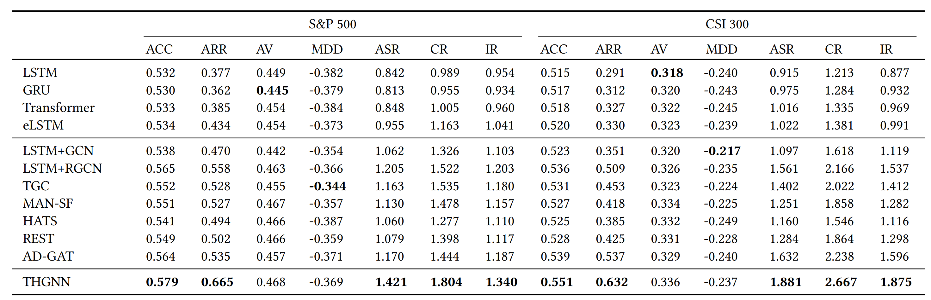
Experiments
Comprehensive Comparison
Notes:
we evaluate the overall performance of financial time series, which is the main task of this paper. The first four rows of the Table show the performance of models that do not use graph-based technology. It is clear that, none of these four methods is satisfactory, and their performance is all lower than that of other baselines. This proves that models without using company relationship data cannot achieve optimal performance. Lines 5 to 11 of the Table show the performance of the baseline models using graph-based technology. According to line 6, LSTM plus RGCN performs better than other graph-based baselines. This proves the effectiveness of using heterogeneous graphs of inter-company relationships. Note that according to line 7, TGC’s performance is also competitive and its investment strategy is less volatile. This proves the effectiveness of using the dynamic relationship between companies.
According to the last row of the Table, our proposed THGNN outperforms all baselines and proves the superiority of temporal and heterogeneous graph neural network in financial time series prediction.

Slide 24
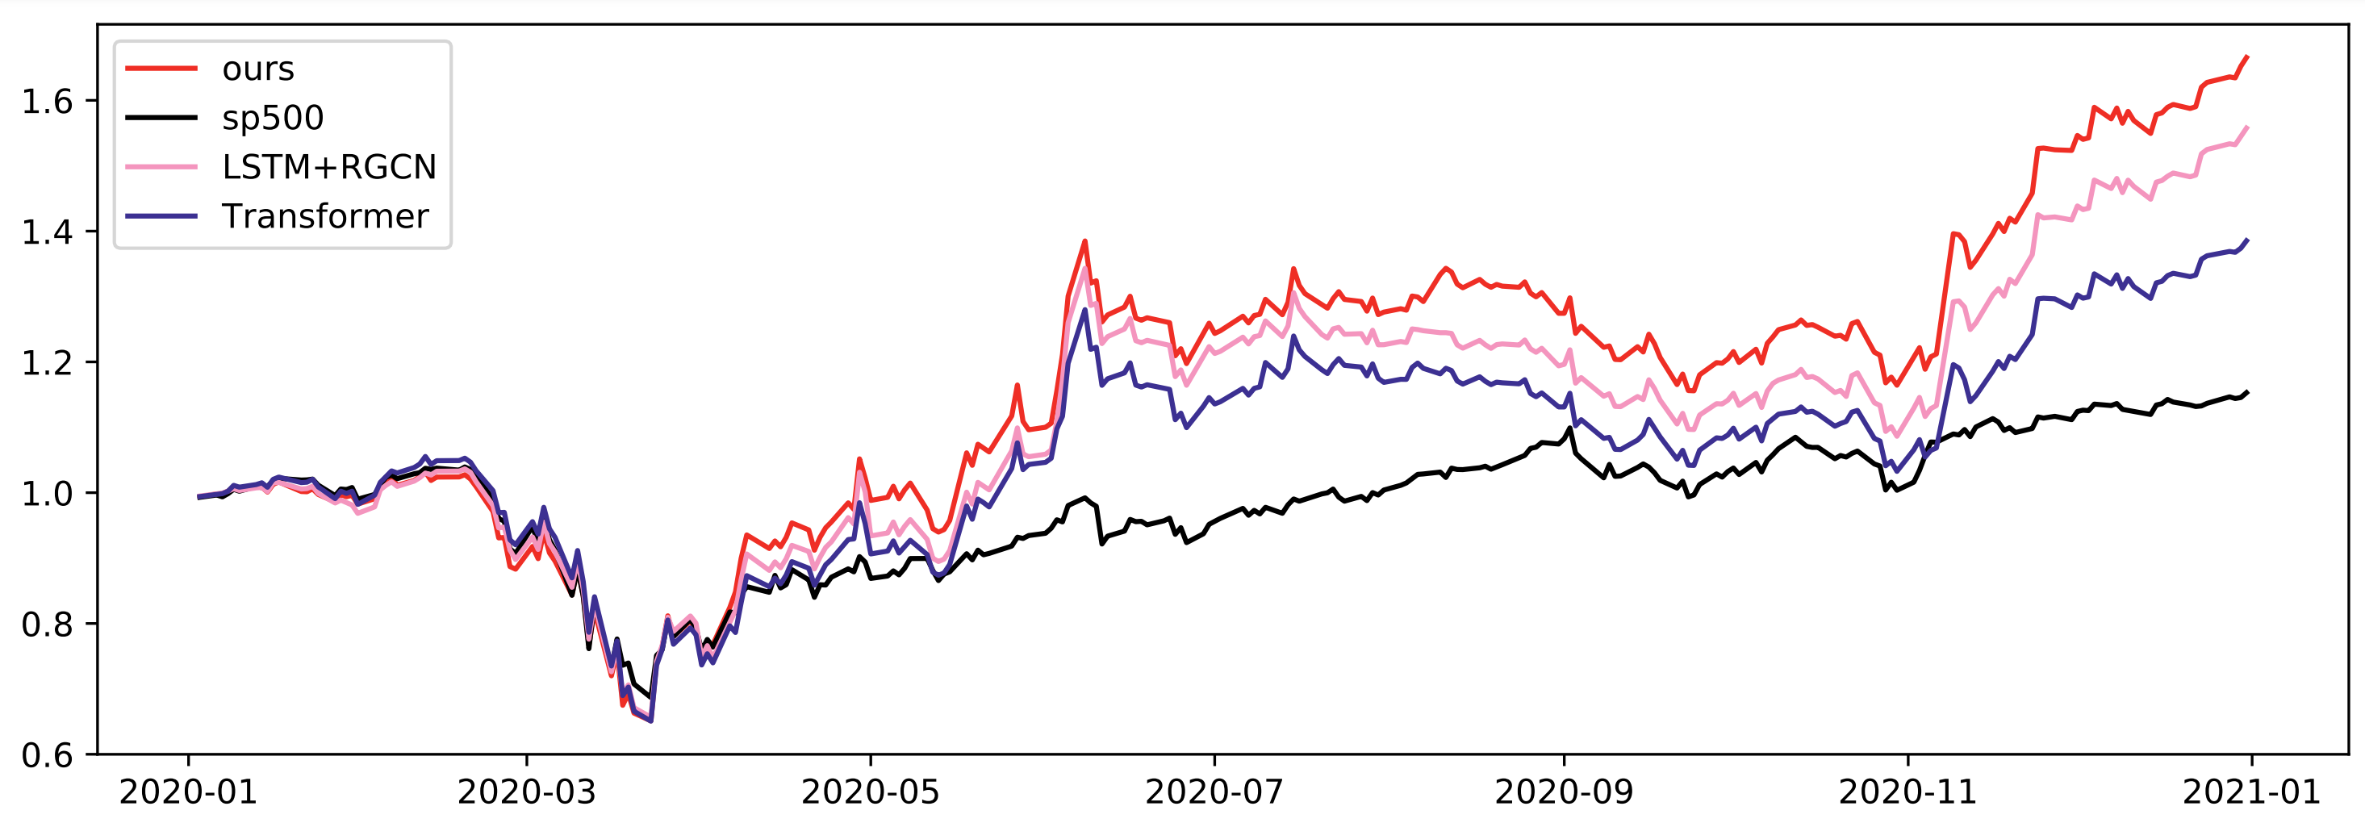
Experiments
Performance of the Portfolio
Notes:
In order to further establish and evaluate the returns of our model during the test time, we calculate the cumulative returns for each trading day during the test period. We report the cumulative return curve of our model and other models on each trading day in the Figure. Due to space constraints, we select some representative baselines to compare with our model. We can observe that all baselines outperform the S&P500 index. None of the models beat the others in the first four months. After starting in May, our model began to stay ahead of other models. In the following time, our model gradually widened the gap with other models. THGNN remained in the lead in the last month of 2020 and eventually achieved a profit on investment of more than 60 per cent. Experimental results on other baselines can draw similar conclusion.

Slide 25
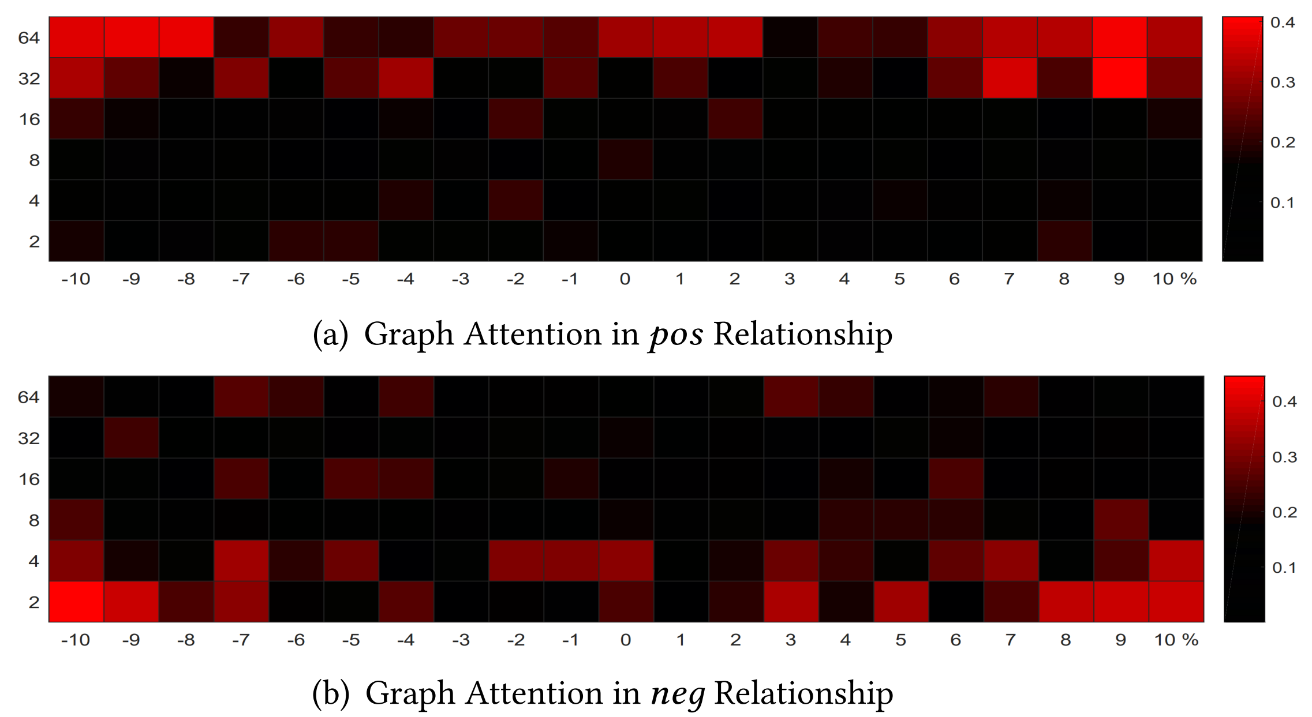
Experiments
Attention Analysis
We counted the attention weight of all nodes in the relational graph. X axis denotes the volatility of return. Y axis denotes the node degree. We can find that:
As to positive neighbors, the nodes with higher degrees have higher average attention weights.
More volatile price changes will contribute more information to their neighbors, or producing momentum spillover effects.
As to negative neighbors, with a lower degree node, the average attention weight is higher.
Notes:
in order to explore the interpretability of our proposed model, we extract the attention weight of the graph in the process of the model prediction. We counted the attention weight of all nodes in the process of message delivery on the relational graph. Under different daily returns and node degrees, we take the mean value of attention weights and visualize the statistical results, which are illustrated in the right figure.

Slide 26
Experiments
Attention Analysis
We counted the attention weight of all nodes in the relational graph. X axis denotes the volatility of return. Y axis denotes the node degree. We can find that:
As to positive neighbors, the nodes with higher degrees have higher average attention weights.
More volatile price changes will contribute more information to their neighbors, or producing momentum spillover effects.
As to negative neighbors, with a lower degree node, the average attention weight is higher.
Notes:
Figure (a) shows the attention weights on the positive relational graph. We can see that the nodes with higher degrees have higher average attention weights. This shows that in the process of message delivery on the 𝑝𝑜𝑠itive relational graph, the degree is higher, that is, the nodes with more neighbors will contribute more messages to their neighbors. We also found that, companies with larger fluctuations in daily returns also had higher average attention weights. This shows that more volatile price changes will contribute more information to their neighbors, which also means that price fluctuations will produce momentum spillover effects.

Slide 27
Experiments
Attention Analysis
We counted the attention weight of all nodes in the relational graph. X axis denotes the volatility of return. Y axis denotes the node degree. We can find that:
As to positive neighbors, the nodes with higher degrees have higher average attention weights.
More volatile price changes will contribute more information to their neighbors, or producing momentum spillover effects.
As to negative neighbors, with a lower degree node, the average attention weight is higher.
Notes:
According to Figure (b), we can see that on the 𝑛𝑒𝑔ative relational graph, with a lower degree node, the average attention weight is higher. This indicates that during message delivery on the 𝑛𝑒𝑔ative relational graph, nodes with lower degrees contribute more messages to their neighbors.

Slide 28
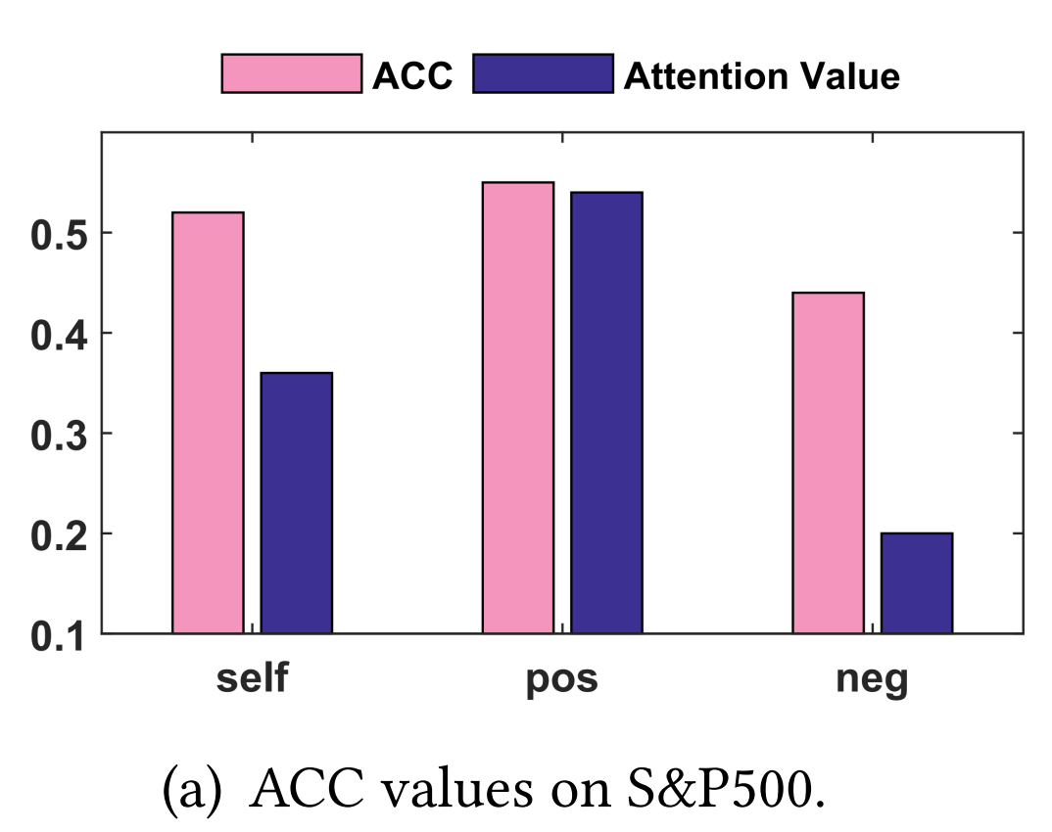
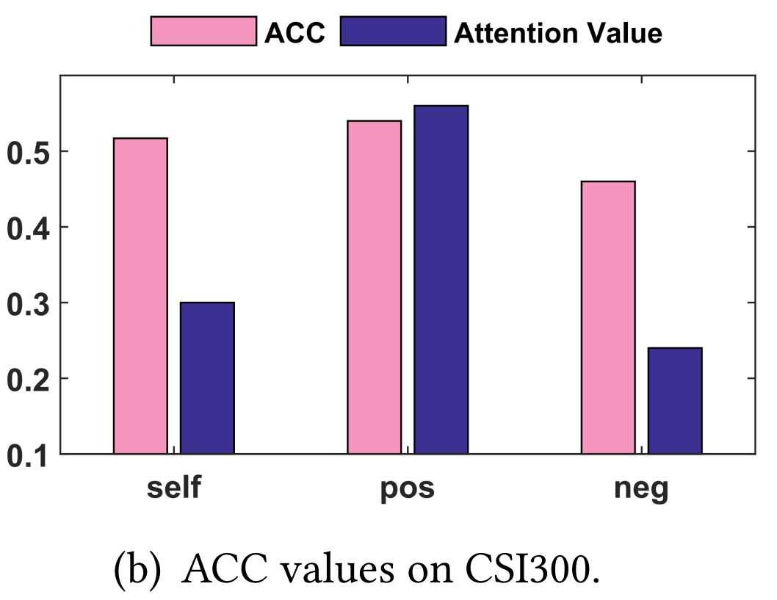
Experiments
Attention Analysis
We show the corresponding performance when using only one relationship.
Postive neighbors can help achieve better prediction performance than negative neighbors.
Negative neighbors provide less but useful information to make our model achieve state-of-the-art performance.
Notes:
For more interpretable experimental results, we also visualize each relationship’s attention weights and show the corresponding performance when using only one relationship. Specifically, we trained our proposed THGNN at two datasets, and counted the mean value of the attention weights in heterogeneous graph attention layer. Then, we used each single relationship’s message as the input of the prediction model to obtain the prediction performance, as illustrated in the right Figure.

Slide 29
Experiments
Attention Analysis
We show the corresponding performance when using only one relationship.
Postive neighbors can help achieve better prediction performance than negative neighbors.
Negative neighbors provide less but useful information to make our model achieve state-of-the-art performance.
Notes:
It is clear that messages from it𝑠𝑒𝑙 𝑓 and 𝑝𝑜𝑠itive neighbors can help achieve better prediction performance than 𝑛𝑒𝑔ative neighbors. Moreover, the 𝑝𝑜𝑠itive neighbor resource contribute more importantly to the prediction model. The reason might be that the influence between companies in the similar price movement is relatively useful for predicting future price movement. Although the 𝑛𝑒𝑔ative related resource has an unsatisfactory performance when predicting price movement single, it still contributes to our proposed THGNN in achieving the state-of-the-art performance.

Slide 30
Content
Background.
Method.
Experiments.
Conclusion
Notes:
Next, we summarize our contributions.

Slide 31
Conclusion
We propose a graph learning framework to effectively model the internal relations among entities for financial time series prediction.
We design a temporal and heterogeneous graph neural network model to learn the dynamic relationships by two-stage attention mechanisms.
Our proposed THGNN is interpretable and can be easily implemented in the industry-level system. Extensive experiments on both the Unite States and China stock markets demonstrate the superior performance of our proposed methods.
Notes:
First, We propose a graph learning framework to effectively model the internal relations among entities for financial time series prediction, which fits the dynamical market status and is concordant with the ground-truth price movements.
Second, We design a temporal and heterogeneous graph neural network model to learn the dynamic relationships by two-stage attention mechanisms. The proposed model is concise and effective in joint and automatically learning from historical price sequence and internal relations.
Third, Our proposed THGNN is interpretable and can be easily implemented in the industry-level system. Extensive experiments on both the Unite States and China stock markets demonstrate the superior performance of our proposed methods. We also extensively evaluated its effectiveness by real-world trading platform.

Slide 32
Thank you!
Sheng Xiang, University of Technology Sydney.
Sheng.xiang@student.uts.edu.au
Notes:
That’s all my presentation. Thank you very much for your listening.

Slide 33
Temporal and Heterogeneous Graph Neural Network for Financial Time Series Prediction
October 17-21, 2022
Atlanta, Georgia, USA
Sheng Xiang¹, Dawei Cheng², Chencheng Shang³ , Ying Zhang¹, Yuqi Liang⁴
¹ The University of Technology Sydney, ² Tongji University,
³ Peking University, ⁴ Seek-data Group
CIKM 2022

